Slide 1
Lecture 13
Statistical computing: Review

Slide 2
Power simulation
### POWER ANALYSIS ########
pfn<-function(alpha,mu,mu0,n,sig,B)
{z<-qnorm(1-alpha)
k<-((z*sig)/sqrt(n))+mu0
pmat<-matrix(0,B,1)
for(i in 1:B)
{sp<-rnorm(n,mu,sig)
xbar<-mean(sp)
pmat[i,]<-ifelse(xbar>k,1,0)}
p1<-sum(pmat)
p1/B}
mns<-seq(20.2,25,0.2)
pwrs<-matrix(0,length(mns),1)
for(i in 1:length(mns))
{pwrs[i,]<-pfn(0.05,mns[i],20,36,4,10000)}
plot(mns,pwrs,type="l",xlab="mean",ylab="power",col=4)
abline(h=0.8,lty=4)
#> mns[8:9]
#[1] 21.6 21.8
ns<-seq(20,50,1)
pwrsn<-matrix(0,length(ns),1)
for(i in 1:length(ns))
{pwrsn[i,]<-pfn(0.05,21.7,20,ns[i],4,10000)}
plot(ns,pwrsn,type="l",xlab="sample size",ylab="power",col=4)
abline(h=0.8,lty=4)

Slide 3
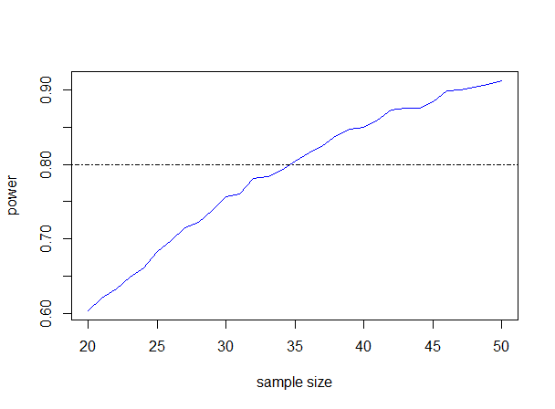

Slide 4
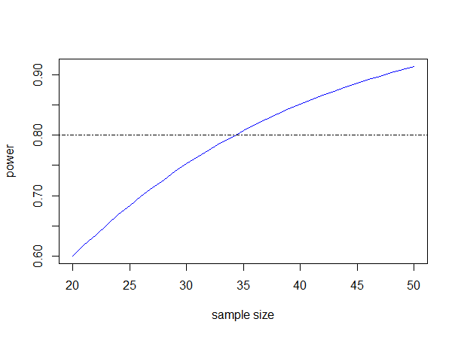

Slide 5
Brownian motion
##GENERATING BROWNIAN MOTION
N <- 100
# number of end - points of the grid including T
T <- 1
# length of the interval [0 , T] in time units
D <- T/N
# time increment
W <- numeric (N +1)
# initialization of the vector W approximating Brownian process
t <- seq (0 ,T , length = N +1)
W <- c(0,cumsum (sqrt(D)*rnorm(N) ) )
plot ( t,W,type ="l", main =" Brownian motion", ylim =c(-1,1)
)

Slide 6
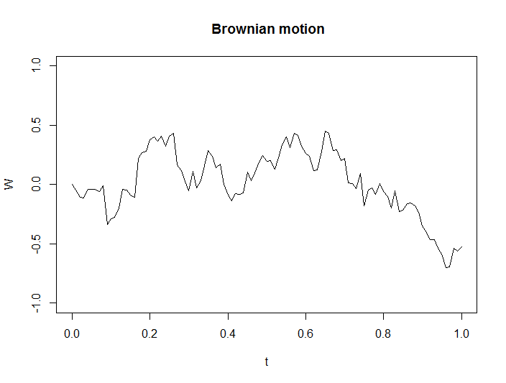

Slide 7
Readings
Martin, A. D., Quinn, K. M., & Park, J. H. (2011). Mcmcpack: Markov chain monte carlo in r. Journal of Statistical Software, 42(9), 1-21.
Martin, A. D., & Quinn, K. M. (2006). Applied Bayesian inference in R using MCMCpack. R News, 6(1), 2-7.

